Slide 1

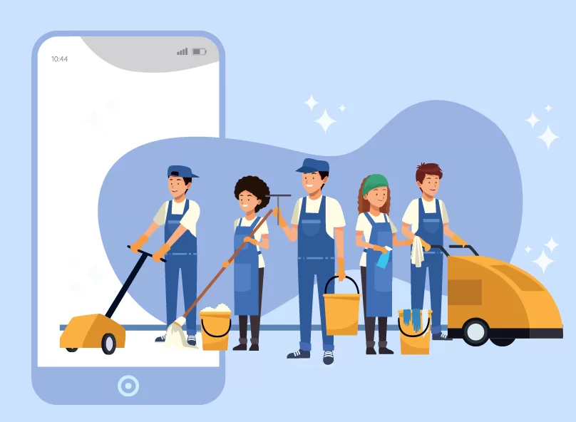
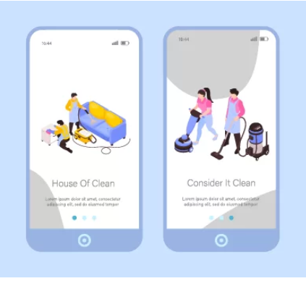
ServiceBOX
A Trusted Professional Hiring Platform
01

Slide 2





Teams Information :
Co-Supervisor
Ms. Sharmin Alom
Lecturer (CSE)
Biplob Adhikary Bappy
ID: 201902198
Sadik Saroar
ID: 212002136
Shamsul Islam Rana
Supervisor
Ms. Fatema Tuj Johora
Lecturer & Progrma Co-ordinator (CSE)
ID: 212002136
02

Slide 3


Table of Contents
Introduction
Problem Description
Goals and Significance
Literature Review
Requirements
Methodology and Diagram
Challenges and Proposed Solution
Tools & Technologies
Conclusion
03

Slide 4



Introduction
App concept
Purpose
Real-world relevance
ServiceBox is a smart, location-based service platform designed to connect users with nearby verified professionals for home services.
Simplifies hiring processfor home repairs and services
ServiceBox is a smart, location-based service platform designed to connect users with nearby verified professionals for home services.
Simplifies hiring process for home repairs and services.
Addresses growing demand in urban Bangladesh.
04

Slide 5


Problem Description
Key Issues
Impact
Difficult to find reliable professionals.
Trust and quality concerns
No centralized platform in urban Bangladesh
Wasted time searching and vetting professional.
Uncertain service results
Limited digital access for locals
05

Slide 6
Goals & Significance
Goals
Significance
Fills gap in urban service markets
Create a reliable tech hiring app
Supports local technician economy
Design smooth user experience
Increases convenience for users
Ensure secure, trusted connections
06

Slide 7

Literature Review and Research Gap
Identification
07

Slide 8



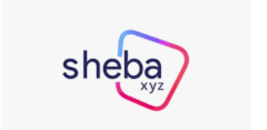
Related Work or Applications
The ServiceBox project aims to develop an all-in-one service platform for the Bangladeshi market. To guide our design, we analyzed existing platforms like UrbanClap, TaskRabbit & Sheba.xyz .
08

Slide 9
Related Work or Website
Common Features of UrbanClap, TaskRabbit & Sheba.xyz :
Online service booking
Verified and trained professionals
User reviews and ratings
Real-time scheduling
09

Slide 10
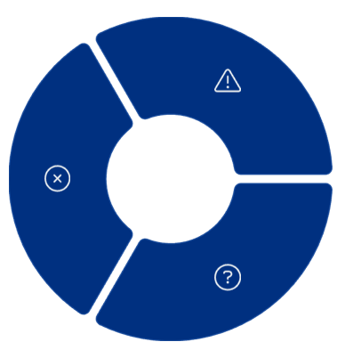



Research Gap Identification
Poor UX
Complex and confusing
interfaces on current apps
Lack of Trust
Users doubtful about technician credibility
Limited Local Focus
Global apps don’t cater to
Bangladesh urban needs
10

Slide 11
Requirements
Functional Requirements :
User Registration & Login
Browse Available Services
Book a Service
View Service Provider Profile
Service Request
Tracking
Payment Integration.
Rate & Review System
Non-Functional Requirements :
Performance
Scalability
Usability
Reliability
Security
Compatibility
Maintainability
10

Slide 12

Methodology Phase and Diagram
11

Slide 13
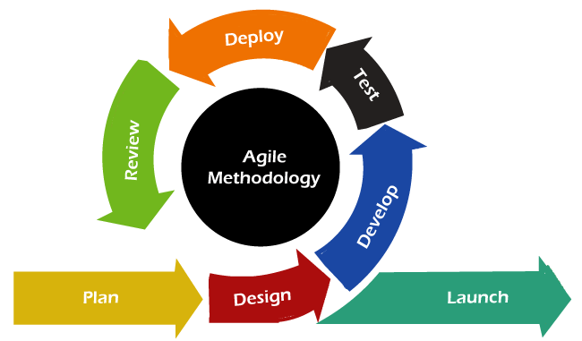
040
Agile SDLC Model for ServiceBox
Why Agile?
Rapid development and iteration for complex multi-site features.
12

Slide 14
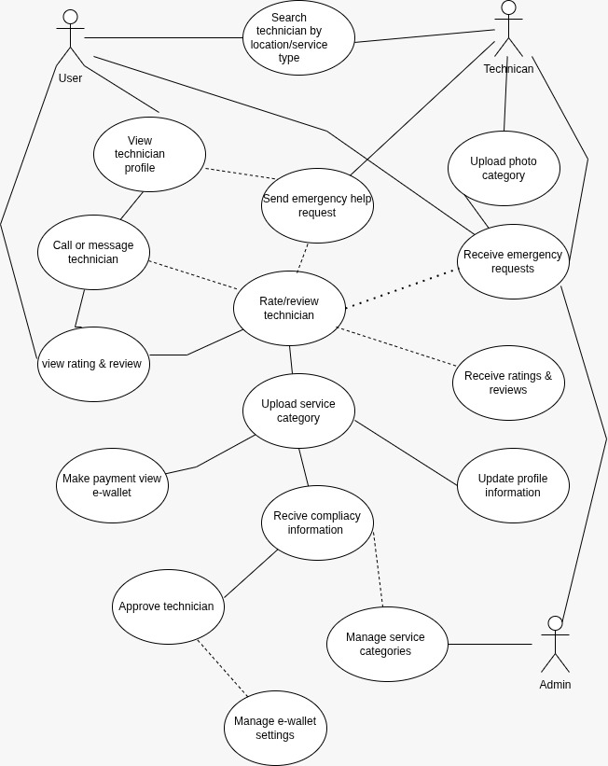
Use Case Diagram
15

Slide 15
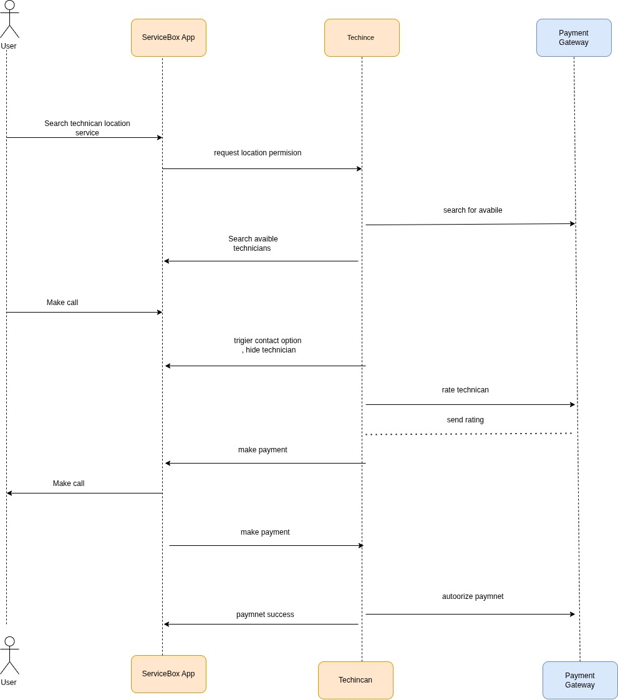
Sequence Diagram
16

Slide 16
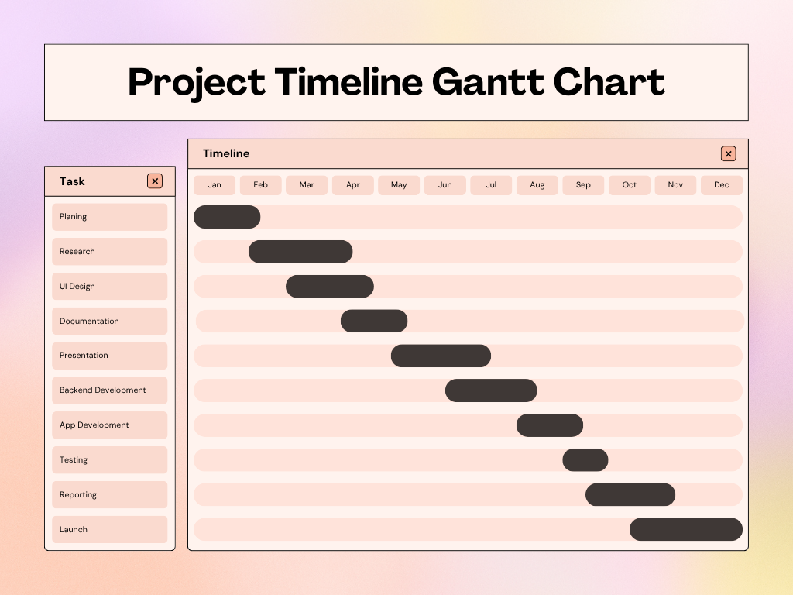
Gantt Chart
17

Slide 17
Item/Service | Description | Estimated Cost (BDT) | Remarks
Developer Honorarium | 3 persons × 5,000 BDT × 5 months (symbolic amount) | 75,000 | Part-time/symbolic cost
Research & Planning | Literature review, documentation, team meetings | 3,000 | Minimal student-level cost
Internet & Hosting | Domain and hosting services for app demo | 3,000 | Shared yearly cost
Hardware Support | Rental/shared laptops or device support | 10,000 | Team-shared hardware
Presentation Costs | Printing, report binding, visual materials | 2,000 | For mid and final presentation
Miscellaneous | Snacks, local travel, emergency expenses | 7,000 | Unexpected or small expenses
Total Estimated Cost |  | 1,00,000
Project
Cost
18

Slide 18
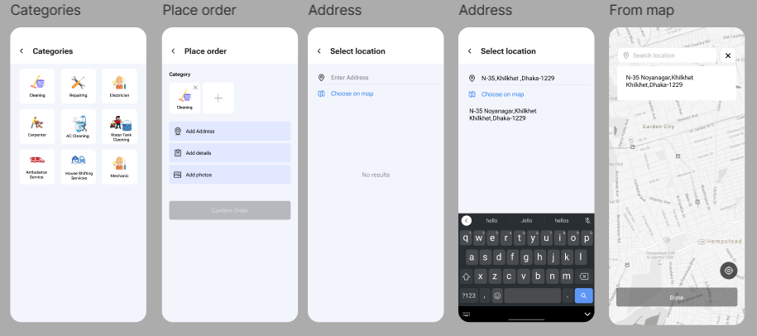
Prototype(Figma Design)
18

Slide 19
Project Challenges & Proposed Solutions
19

Slide 20
Challenges & Proposed Solution
Challenges :
Ensure accurate professionals-location matching in real-time.
Verify professionals identities and preventing fraud.
Supporting service requests in offline or low-connectivity areas.
Manage multiple user roles (Users, Technicians, Admins).
Proposed Solutions :
Use of GPS-based filtering for location-accurate technician listings.
NID-based technician verification with admin approval.
SMS-based request system for offline accessibility.
Role-based access control to manage different user types securely.
20

Slide 21
Tools & Technologies Used
Tools & Technologies Used
Frontend:
Flutter (for cross-platform mobile app development)
Backend:
Node.js / Express.js (for API development)
Firebase
Authentication & Verification:
Firebase Authentication / JWT
APIs & Services:
Google Maps API (for location tracking and filtering)
Twilio (for SMS-based emergency/offline services)
Other Tools:
VS Code
Git & GitHub (for version control)
20
21

Slide 22

Conclusion
22

Slide 23



Summary
Problem
Lack of reliable technician hiring platforms
Goals
Create secure, user-friendly hiring applications. ServiceBox aims to solve real-life service accessibility challenges through a user-friendly and reliable digital solution.
Progress
Design and development near completion scalability, security, and local relevance in mind.
23

Slide 24
Future Work
Integrate Payment System
Ensure secure user transactions
App Launch
Release on Android and iOS platforms
Expand Services
Add more categories like telemedicine services.
User Feedback
Gather feedback for iterative improvements
24
24

Slide 25
References
1. Online Home Services Platform.
Available at: https://www.urbancompany.com (Accessed: 2023-10-20).
TaskRabbit. Task Marketplace for Freelancers.
Available at: https://www.taskrabbit.com (Accessed: 2023-10-20).
Sheba.xyz. On-Demand Service Platform in Bangladesh.
Available at: https://www.sheba.xyz (Accessed: 2023-10-20).
Firebase Documentation. Backend Platform by Google.
Available at: https://firebase.google.com/docs (Accessed: 2023-10-20).
25

Slide 26
Thank you!
26

